Slide 1

Oliver HArdy rrsp analysis
Report by:
Muhammed Shahjahan
Seneca Financial Solutions

Slide 2
Alfred Newman RRSP
Current Portfolio
Asset Classes | Current Asset Mix | Value
Brandes Canadian Money Market | 14% | $14,000
Scotia Canadian Bond A | 56% | $56,000
CIBC Canadian Equity | 23% | $23,000
TD US Index I (CDN$) | 4% | $4,000
MD International Growth | 3% | $3,000
Total | 100% | $100,000
Notes:
Here is your portfolio as it currently is set up.
You’ve got:
14% of your portfolio in the Brandes Canadian Money Market,
56% of your portfolio in the Scotia Canadian Bond A
23% of your portfolio in the CIBC Canadian Equity
4% of your portfolio in the TD US Index I (CDN$)
And 3% of your portfolio in the MD International Growth

Slide 3
Alfred Newman RRSP
Oliver Hardy Review
Here is your current Asset mix compared with the desired investment mix that is the result of the questionnaire you filled out.
Now why is this important?
Asset Classes | Current Mix | Investor Profile: Aggressive Growth | Oliver Hardy Rebalance
Cash | 14% | 0% | -14%
Fixed Income | 56% | 10% | -46%
Canadian Equity | 23% | 30% | +7%
US Equity | 4% | 30% | +26%
Foreign Developed Equities | 15% | 20% | +5%
Foreign Emerging Markets Equities | 0% | 10% | +10%
Notes:
Breaking those holdings down into your asset mix, here is what we see. Compared with the result of the Investor Profile you filled out, you can see that the two Oliver Hardy mixes are quite different.
As you can see, your current asset mix is not in line with your goal. As per the questionnaire, you are a Growth oriented investor, with a long-time horizon until retirement, and with a desire to invest in mostly equity investments. Growth investors are comfortable with high short-term losses with an understanding that those losses are a trade-off for higher long-term returns.
Your current asset mix is heavily weighted towards Cash and Fixed Income with a 60% weighting towards those two asset classes combined. This implies a Balanced Conservative approach which might be more appropriate for someone who is much closer to retirement and who perhaps has a lot lower tolerance for risk than you’ve indicated that you have.
From an equity point of view, you’re heavily weighted in Canadian Equities, but with minimal exposure to the rest of the globe. Beyond the return potential, there are many emerging markets and investing in those markets create greater diversification for your portfolio beyond simply Canada, thus providing some additional protection for your nest egg.
Let’s look a little deeper into your current holdings…

Slide 4
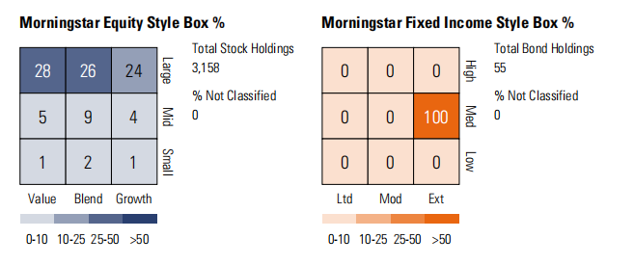
Alfred Newman RRSP
Portfolio Analysis: Style Box
As you can see, your present portfolio is significantly weighted toward large cap shares, with a modest percentage in mid cap and a negligible number in small cap.
Given your orientation towards a more aggressive growth oriented portfolio, in addition to your long time horizon, some exposure to small cap, equities would give you an opportunity to potential achieve a higher return for a little additional risk.
This will increase the likelihood of achieving your goal to retire at 65.
Notes:
Your current investment holds for more than 85% into large cap equities which is a good aspect if you are looking for a lower volatility, greater analyst coverage, or perhaps a steady dividend stream. But they never gives high returns as they are considered more stable and mature investments.
The huge upside growth potential that smaller firms lack makes investing in individual small-cap stocks the best option. Additionally, passive investors have a means to increase returns by using small-cap value index funds. For small-cap investors, merger and acquisition activity presents another possibility.
So that is the huge turn around which we should be focussing on so as to get high return on investment.
Also we should focus on investing on both value and growth stocks as both have their own ups and downs but have high return in common, ie When economic conditions are good, growth stocks on average modestly outperform value stocks. During more difficult economic times, value stocks tend to hold up better.

Slide 5
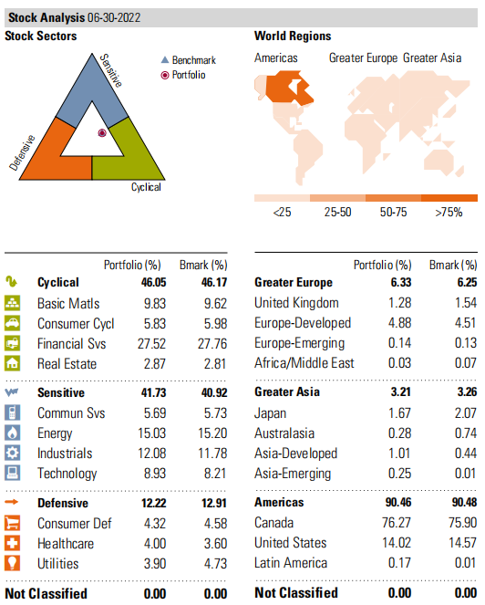
Alfred Newman RRSP
Portfolio Analysis: Sector/Region Analysis
-Your portfolio leans heavily towards cyclicals such as financials (27.52%) and basic materials (9.83%), and Sensitives such as energy(15.03%), industrials(12.08%), and technology(8.93%). -This demonstrates a high exposure to the Canadian equity market (where financials, energy, and mining are dominant). -When we then look at the World Regions graphic, we can see that this is indeed the case with a 76.27% exposure to Canada, a 14.02 in the US, and not much elsewhere. -Going forward, to be in line with your goals and your investor profile, we’d like to see your Sector exposure be more diversified across Cyclicals, Sensitives, and Defensives in addition to global diversification across all the world regions.
Notes:
-Your portfolio leans heavily towards cyclicals such as financials (27.52%) and basic materials (9.83%), and Sensitives such as energy(15.03%), industrials(12.08%), and technology(8.93%).
-This demonstrates a high exposure to the Canadian equity market (where financials, energy, and mining are dominant).
-When we then look at the World Regions graphic, we can see that this is indeed the case with a 76.27% exposure to Canada, a little in the US, and not much elsewhere.
-Going forward, to be in line with your goals and your investor profile, we’d like to see your Sector exposure be more diversified across Cyclicals, Sensitives, and Defensives in addition to global diversification across all the world regions.
Investing in healthcare has huge potentials especially after the covid. Similarly Real estate is another sector which is having tremendous growth here in Canada.

Slide 6
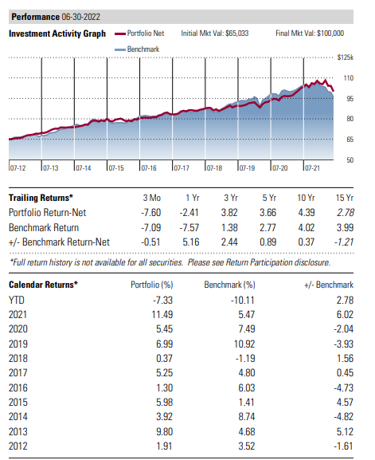
Alfred Newman RRSP
Portfolio Analysis: Performance
-The portfolio has lagged the benchmark portfolio by a considerable amount over the last 5 years performing at 3.66% while the benchmark portfolio with similar Oliver Hardy delivered 2.77%. -Even over the last year, the portfolio has been on the losing end by a sizeable amount of -2.41%. -As we can see in the graph, if you invested $65,033 in Sept, 2017, you’d have $100,000 as of month end. Had you invested in the benchmarks, you’d have just over $110,000, so a disappointing return overall. -Finally, If we analyze calendar year returns, we see underperformance in each year since 2017.
Notes:
-The portfolio has lagged the benchmark portfolio by a considerable amount over the last years performing at -2.41% while the benchmark portfolio with similar Oliver Hardy delivered -7.57% and hence I think it was far better.
-As we can see from the graph, if you had invested $65,033 in September 2017, by the end of the month you would have $100,000. You would have just over $110,000 now if you had invested in the benchmarks, which is a lacklustre total return.

Slide 7
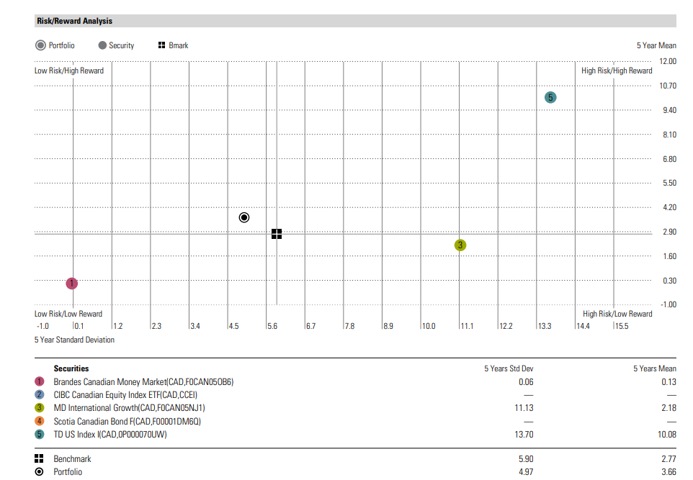
Alfred Newman RRSP
Portfolio Analysis: 3 yr Risk/Reward Scatterplot
Notes:
This graph seeks to show you whether you are getting an adequate return on your risk. Statistics may be used to map the risk of an investment along a horizontal axis and the return along a vertical axis. While it would be wonderful, we cannot anticipate making enormous profits with no risk. We truly want to get the highest returns feasible given the risk we are incurring. This graph seeks to show you whether you are getting an adequate return on your risk. Statistics may be used to map the risk of an investment along a horizontal axis and the return along a vertical axis. We truly want to get the highest returns feasible given the risk we are incurring.

Slide 8
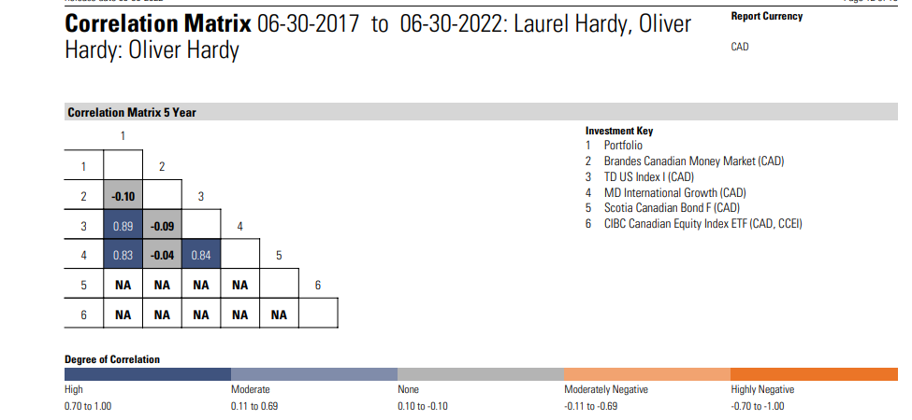
Alfred Newman RRSP
Portfolio Analysis: Correlation Matrix
The link between return patterns for various investments is shown by the correlation matrix. The values range from -1 to 1. A correlation between two assets that is 100 percent negative is denoted by a minus 1. (i.e. if investment goes up, the other goes down). If two investments have a perfect positive correlation of 1, then both will increase in value. A 0 or near to it indicates that there is no correlation between the two investments.

Slide 9
Alfred Newman RRSP
Oliver Hardy Review
Here is your current Asset mix compared with the desired investment mix that is the result of the questionnaire you filled out.
Now why is this important?
Asset Classes | Current Mix | Investor Profile: Growth | Oliver Hardy Rebalance
Cash | 14% | 0% | -14%
Fixed Income | 56% | 20% | -46%
Canadian Equity | 23% | 25% | +7%
US Equity | 4% | 25% | +26%
Foreign Developed Equities | 15% | 20% | +5%
Foreign Emerging Markets Equities | 0% | 10% | +10%
Notes:
Returning to our starting point again, given all that we’ve discussed, we’d like to recommend some changes to your portfolio.
Starting with your asset mix, we’d like to see you adjust your holdings as follows.
Reduce your cash position to zero. You don’t need a cash investment in your RRSP, unless you’re trying to time the market, which is not something we do here at Forward Looking Financial Solution which I’ll explain in a moment. The one caveat with this is that Caroline is currently laid off and looking for work (with minimal savings). If you believe that there’s any risk that you will need to access your RRSP to help pay for day-to-day expenses while she’s looking, it might be wise to leave a few months worth of cash available to draw on. We have noted that you’re currently running a cash flow deficit and that does raise some concerns. Can you get that deficit back down to zero by adjusting some of your discretionary spending? If you can then that would be ideal. Then you can ensure you are maintaining the tax deferral that the RRSP provides until you need it in retirement.
Reduce your Fixed Income position by 20%
Reduce your Canadian Equity position by 5%
Increase your US Equity position by 20%. The US is the largest economy in the world and provides high levels of exposure to sectors such as technology, healthcare, consumer staples, and discretionary as well as several others. Remember, Canada is largely financials, energy, and materials. Exposure to the world’s largest market is an excellent way to both enhance and diversity your portfolio.
Increase your Foreign Developed Equity position by 15%. This will provide you with exposure to Western Europe, Israel, and Australasian markets such as Australia, Hong Kong, Japan, New Zealand, and Singapore.
And Increase your Foreign Emerging Markets Equity position by 10%, which will give you exposure to huge growth markets such as India, China, Mexico, and many others. Yes, these markets do come with higher short-term volatility, but their growth potential gives your portfolio the opportunity to achieve a higher long-term rate of return. Since you’re still 30 years to retirement, if you can handle the volatility, you should be rewarded for the risk you’re taking.
Once this Oliver Hardy is set up, it will remain as is. As your various investment positions go up (and sometimes down), we may find that this Oliver Hardy gets out of position. When it does, we take the opportunity to rebalance it back to your original growth profile. The real advantage of doing this is that it essentially puts you in a position to be selling something at a high price and buying it a low one. That’s investing 101 isn’t it? We call this approach strategic Oliver Hardy.
One other factor you’ve discussed with us is the fact that you’d like to provide for your child’s education. We would suggest you set up an RESP as soon as possible and begin funding it with a dollar cost averaging approach with whatever you can afford. That may be a challenge right now because of Caroline’s job situation; however, as soon as she’s working again, that should be part of your planning. We would be happy to help set that up for you.
Now that we’ve discussed your current portfolio and asset mix, and the recommended new growth asset mix, let’s take a look at the individual investment holdings we’d like to recommend to you.

